Slide 1


Generative AI
https://github.com/arunpa0206/generativeai
Confidential
Notes:
https://github.com/arunpa0206/generativeai

Slide 2




About Techcovery
Founded in 2017 by ex-Amazon Employees
Over 3200 hours of training in
Machine Learning
Deep Learning
Computer Vision
Golang
Amazon-Web services
Go and Python
Confidential
2

Slide 3
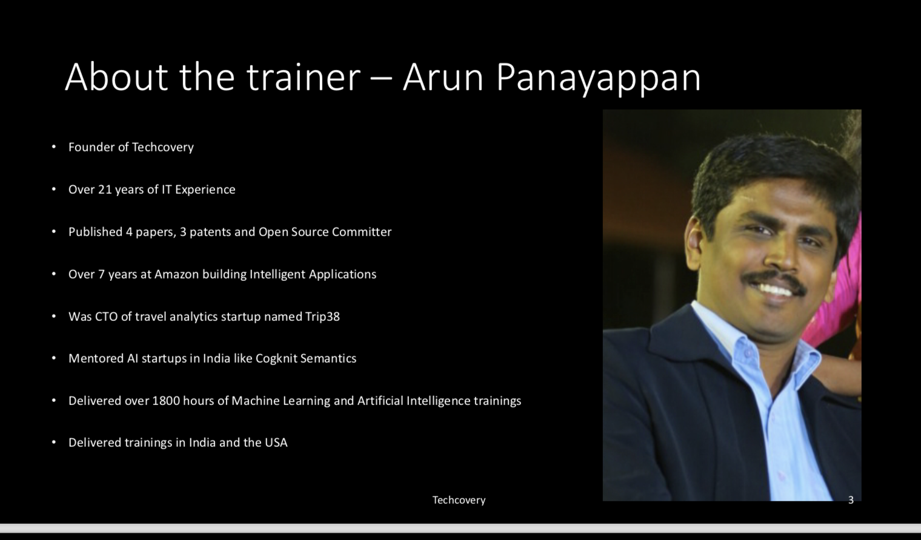
About the Trainer
Founder of Techcovery
Over 21 years of IT experience
Published 4 papers, 3 patents and Open Source Committer
Over 7 years at Amazon building Intelligent Applications
Was CTO of travel analytics startup named Trip38
Mentored AI startups in India like Cogknit Semantics
Delivered Over 1800 hours of Machine Learning and AI Training
Delivered Trainings in India and USA
Confidential
3

Slide 4


















Agenda
What is Generative AI?
Categories of AI
Why Generative AI?
Usecase of Generative AI
Case Study
Confidential
4

Slide 5

What is Generative AI?
Generates original and creative content
Learn patterns from existing data
Models can be interactive and adaptive
Confidential
5

Slide 6
Categories of AI
Artificial Intelligence
Machine Learning
Deep Learning
Generative
Discriminative
Unimodal
Multimodal
Confidential
6

Slide 7
How is Generative AI different from Web search?
Generative AI | Web search
Create new and unique content | Retrieves existing information from the internet
Requires training data | Uses web crawling technique
Example: Chat GPT, DALL-E, Hugging Face | Example: Google Search, Bing
Confidential
7

Slide 8





Tools for Text generation
Confidential
8

Slide 9
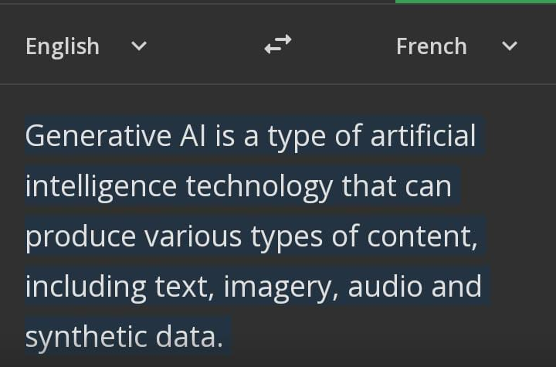
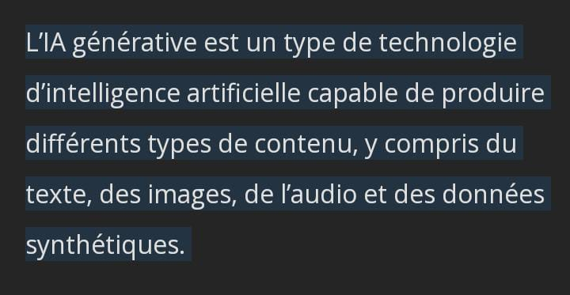
Industry use cases of Generative AI
Text Translator
Chat GPT
Confidential
9

Slide 10
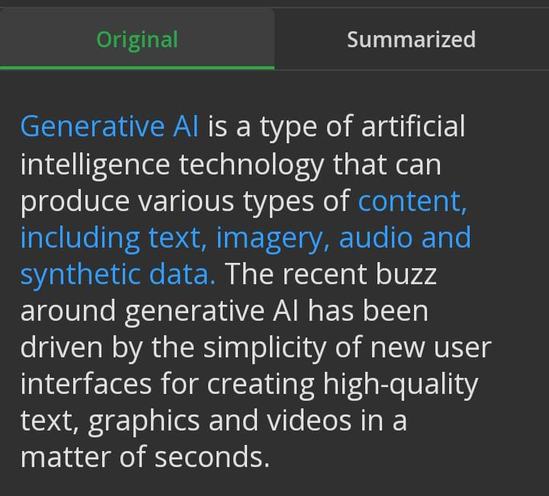
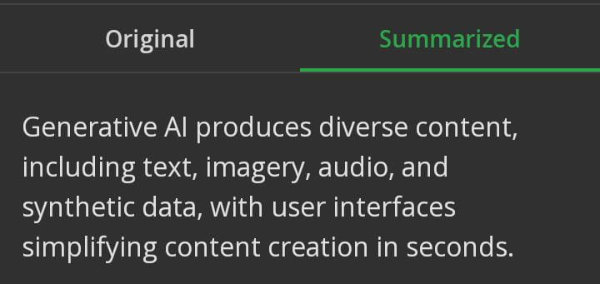
Text Summarization
Chat gpt
Confidential
10

Slide 11
Question Generation
What is Generative AI?
What is the primary role of Generative AI in neural networks ?
Describe the purpose of Generative AI?
Generative AI creates new and original content using neural networks.
Chat GPT
Confidential
11

Slide 12
Subject: Job Offer: Data Scientist Position at Techcovery Solutions
Dear [Candidate's Name],
Congratulations! We are pleased to offer you the position of Data Scientist at Techcovery Solutions. Your skills, qualifications, and interview performance have impressed us, and we believe you will be a valuable asset to our team.
Position Details:
Position Title: Data Scientist
Department: Analytics
Start Date: [Date]
Compensation: [Salary/Package]
We are excited to have you join our team. Please review the attached offer letter and let us know your decision by [deadline]. Feel free to reach out if you have any questions or need further clarification.
We look forward to your positive response and welcoming you to Techcovery Solutions!
Best regards,
[Your Name]
[Your Title/Position]
[Techcovery Solutions]
[Contact Information]
Email Composition
Generate an email for the offer of employment as a data scientist in techcovery solutions
Chat gpt
Confidential
12

Slide 13






Tools for Image generation
Confidential
13

Slide 14
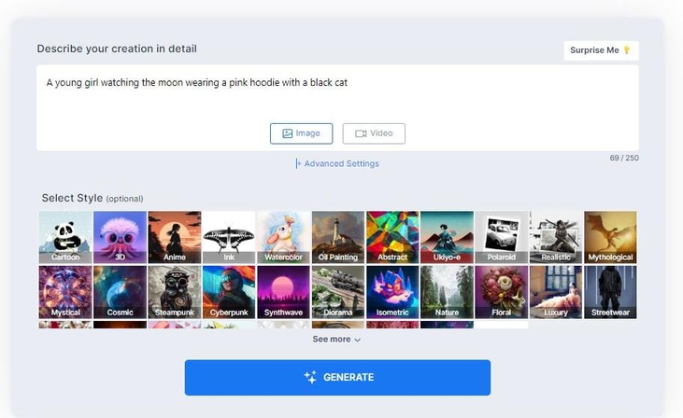
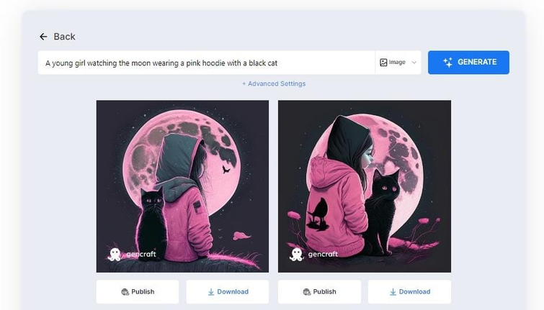
Image generator
Gencraft
Confidential
14

Slide 15

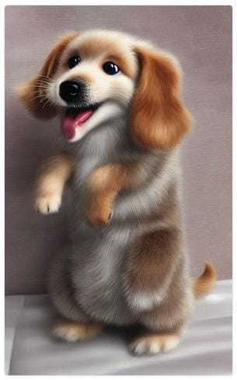
Image generator
Scribble diffusion
Confidential
15

Slide 16






Tools for Music Generator
Confidential
16

Slide 17
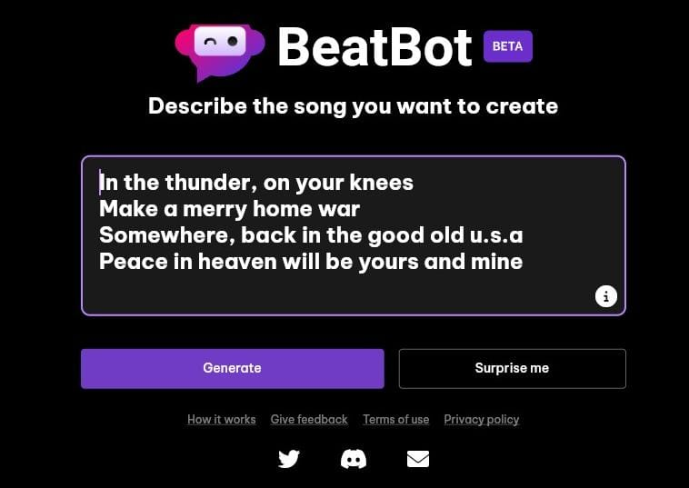

Music generator
Beatbot AI
Confidential
17

Slide 18

Music Generator
Beatbot AI
Confidential
18

Slide 19





Tools for Video generation
Confidential
19

Slide 20
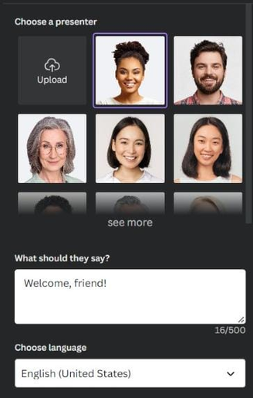
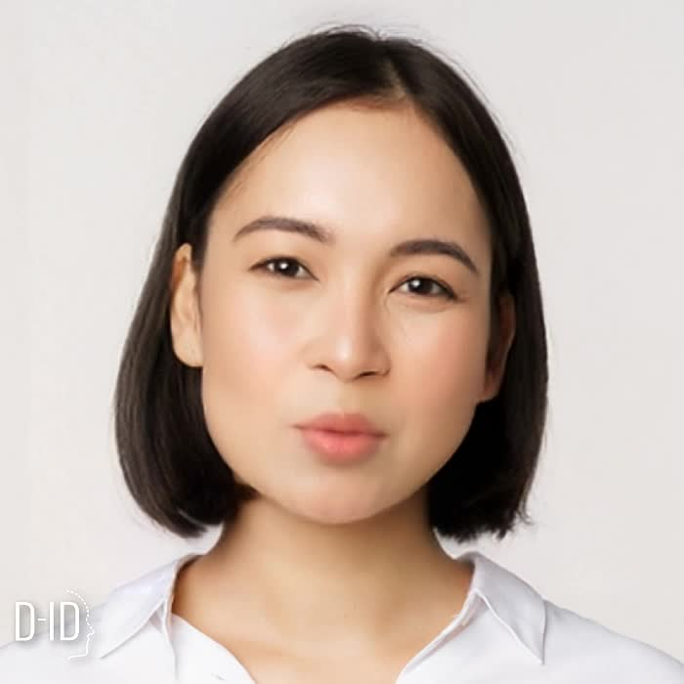
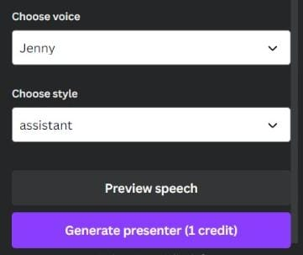
Video Generator
D -ID
Hello,I am Lily, your personal PA.
Confidential
20

Slide 21


Tools for virtual reality
Confidential
21

Slide 22


Virtual Reality
Deep motion
Confidential
22

Slide 23









Other Generative AI models
Design
Coding
Productivity
Confidential
23

Slide 24
Case Study

Slide 25


Case Study - CXO Concierge
Customer : Kepler
Problem:
Kepler is a start-up that aims to build a CXO concierge for large companies. Kepler wanted a chat platform using generative AI to answer questions
Solution:
Techcovery helped bootstrap Kepler for a customer launch in Q3 2023
Techcovery built a platform architecture and delivered an LLM first strategy to Kepler.
A team of data scientists from Techcovery built the platform

Slide 26
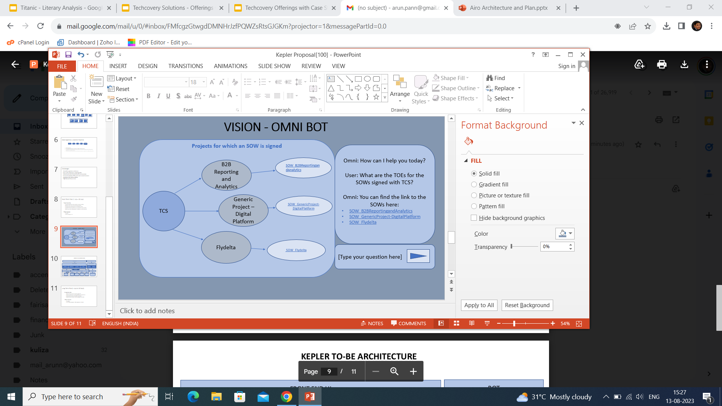
Vision

Slide 27
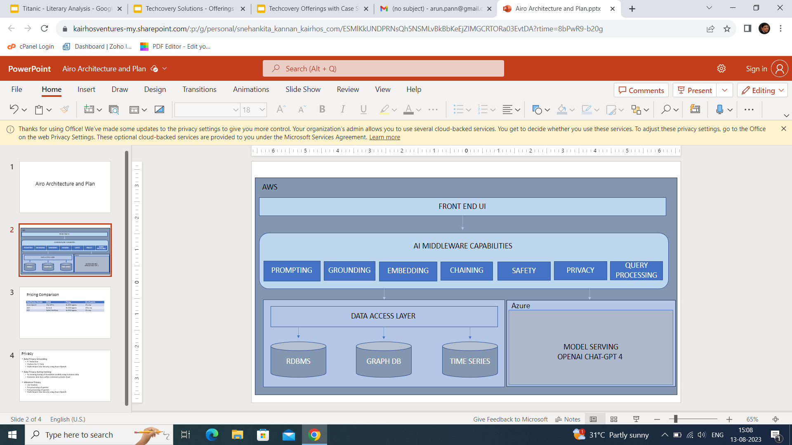
Solution Architecture

Slide 28
Generative AI Workshop
https://github.com/arunpa0206/generativeai
Confidential

Slide 29
About Techcovery
Founded in 2017 by ex-Amazon Employees
Over 3200 hours of training in
Machine Learning
Deep Learning
Computer Vision
Golang
Amazon-Web services
Go and Python
Confidential

Slide 30
About the Trainer
Founder of Techcovery
Over 21 years of IT experience
Published 4 papers, 3 patents and Open Source Committer
Over 7 years at Amazon building Intelligent Applications
Was CTO of travel analytics startup named Trip38
Mentored AI startups in India like Cogknit Semantics
Delivered Over 1800 hours of Machine Learning and AI Training
Delivered Trainings in India and USA
Confidential

Slide 31
Agenda
What is Generative AI?
Introduction to NLP
Transformers
Prompt Engineering
Chaining
Factuality and Safety
Confidential

Slide 32
Categories of AI
Artificial Intelligence
Machine Learning
Deep Learning
Generative
Discriminative
Unimodal
Multimodal

Slide 33
ChatGPT API Setup

Slide 34

Step 1. Create an OpenAI account

Slide 35
Step 2. Generate an OpenAI API Key

Slide 36
ChatGPT Hands-on

Slide 37
Informational Questions
Who was the founder of Generative AI?

Slide 38
Math and Reasoning
Prove the central limit theorem.
Write the multiplication table of 8

Slide 39
Planning Questions
Generate a tour plan to Paris with a budget of $5000 for 3 days.
Generate a business plan for a Generative AI startup.

Slide 40
Fastest Fingers First
Get ChatGPT to hallucinate.

Slide 41
Introduction to NLP

Slide 42
Brainstorm
Classify movie review as Positive, Negative or Neutral Sentiment.

Slide 43

Transformer Neural Network
Confidential
24

Slide 44

Transformer Neural Network
Solve sequence-to-sequence tasks while handling long-range dependencies
Attention Is All You Need
Relies on self-attention mechanisms
25
Notes:
https://proceedings.neurips.cc/paper_files/paper/2017/file/3f5ee243547dee91fbd053c1c4a845aa-Paper.pdf
https://engineering.purdue.edu/DeepLearn/pdf-kak/Transformers.pdf
https://www.researchgate.net/publication/366517405_Data_Science-Neural_Networks-05-Transformer_Neural_Network

Slide 45
Internal representation
Spirit in the sky
[ ]
1 0 0 0
0 1 0 0
0 0 1 0
0 0 0 1
Encoder
Decoder
esprit dans le ciel
Confidential
26
Notes:
https://proceedings.neurips.cc/paper_files/paper/2017/file/3f5ee243547dee91fbd053c1c4a845aa-Paper.pdf
https://engineering.purdue.edu/DeepLearn/pdf-kak/Transformers.pdf

Slide 46
Transformer
Attention Head
Q(nxn)
K(nxn)
V(nxn)
Input Embedding
Feed Forward
Decoder
Confidential
27
Notes:
*The encoder is responsible for processing the input sequence and producing a continuous representation, or embedding, of the input.
*It allows the transformer to learn long-range dependencies between the input tokens.
Benefits:
* It can process the input sequence in parallel.
* It can learn to ignore irrelevant information.
https://proceedings.neurips.cc/paper_files/paper/2017/file/3f5ee243547dee91fbd053c1c4a845aa-Paper.pdf
https://engineering.purdue.edu/DeepLearn/pdf-kak/Transformers.pdf

Slide 47
Encoder representation
Attention Head
Q(nxn)
K(nxn)
V(nxn)
(
Softmax Q.K
(
V
Feed Forward
Input Embedding
Concat
dk
Output
Confidential
28
Notes:
https://proceedings.neurips.cc/paper_files/paper/2017/file/3f5ee243547dee91fbd053c1c4a845aa-Paper.pdf
https://engineering.purdue.edu/DeepLearn/pdf-kak/Transformers.pdf

Slide 48
Sequence Diagram
Input Embedding
Attention head
Concat
Feed forward
Output
Input
Query
Key
( )
QxK
T
Softmax
Value
dk
Attention score
normalized attention
output
spirit
0.96
-0.55
1.07
1.14
-0.73
0.94
-0.46
-0.44
-1.24
0.97
-1.41
-1.41
1.00
-1.36
0.80
0.71
in
the
sky
29
Notes:
Input Embedding: Converts input tokens into dense vector representations (embeddings) that capture the semantic meaning of the tokens.
Query: Represents the current token being processed in the encoder sequence, used to compute its attention scores with respect to other tokens.
Key: Represents all tokens in the encoder (input sequence), used to compute the attention scores with respect to the current query token.
Value: Represents the corresponding embeddings of the encoder tokens, used to compute the weighted sum based on the attention scores to obtain the context representation for each token in the encoder sequence.
Attention Head: Calculates attention weights for each token in the input sequence by measuring its relevance to other tokens using dot-product attention.
The attention score is a measure of the similarity or relevance between the query and the key used to determine the importance of each key with respect to the current query token
Concatenation: Combines the outputs from multiple attention heads, creating a single tensor with enriched context information.
Feedforward: Applies two fully connected layers with a non-linear activation function in between to process and transform the concatenated context information, capturing higher-level relationships in the data.
https://proceedings.neurips.cc/paper_files/paper/2017/file/3f5ee243547dee91fbd053c1c4a845aa-Paper.pdf
https://engineering.purdue.edu/DeepLearn/pdf-kak/Transformers.pdf

Slide 49
Embedding Layer
Embedding
Positional Encoding
Embedding with time signal
+
=
Confidential
33
Notes:
The embedding layer is used to convert discrete data into continuous vector representations known as embeddings.
Embeddings reduce the dimensionality of the input data.
Embeddings capture semantic relationships between words, allowing the model to understand word associations and generalize better to unseen words.
https://proceedings.neurips.cc/paper_files/paper/2017/file/3f5ee243547dee91fbd053c1c4a845aa-Paper.pdf
https://engineering.purdue.edu/DeepLearn/pdf-kak/Transformers.pdf

Slide 50
Final Input vector
Embedded vector
Position vector
−2.00
7.99
4.32
−5.35
0.03
-0.54
9.56
2.84
8.44
-4.67
1.10
-2.57
5.32
-6.99
6.78
0.01
0.00
0.84
0.90
0.14
1.00
0.54
-0.42
- 0.99
0.00
0.01
0.02
0.03
1.00
0.99
0.99
0.99
spirit
spirit
+
in
in
the
the
sky
=
sky
Final Input vector
−2.00
8.83
5.22
-5.21
1.03
0.00
9.14
1.85
8.44
-4.66
1.12
-2.54
6.32
-6.00
7.77
1.00
spirit
in
the
sky
Confidential
38
Notes:
https://proceedings.neurips.cc/paper_files/paper/2017/file/3f5ee243547dee91fbd053c1c4a845aa-Paper.pdf
https://engineering.purdue.edu/DeepLearn/pdf-kak/Transformers.pdf

Slide 51
Decoder
Confidential
59

Slide 52
Decoder
Masked Attention Head
Q(nxn)
K(nxn)
V(nxn)
Attention Head
Q(nxn)
K(nxn)
V(nxn)
Feed Forward
Target Embedding
Output probabilities
Softmax
Linear
Confidential
60
Notes:
https://proceedings.neurips.cc/paper_files/paper/2017/file/3f5ee243547dee91fbd053c1c4a845aa-Paper.pdf
https://engineering.purdue.edu/DeepLearn/pdf-kak/Transformers.pdf

Slide 53
Sequence Diagram
Input Embedding
Mask Attention head
Encoder- Decoder Attention head
Feed forward
Linear
Softmax
Target
Query
Key
( )
QxK
T
Softmax
dk
Value
Encoder output
Encoder-Query
Encoder-Key
( )
QxK
T
Softmax
dk
Decoder-Value
output
attention score
Target output
esprit
0.03
0.20
0.19
0.58
Linear output
dans
le
ciel
Notes:
Target Embedding: Converts target tokens (output sequence) into dense vector representations (embeddings) to capture the semantic meaning of the tokens.
Query - the current token being processed
Key - all tokens in the input sequence
Value- the corresponding embeddings of the encoder tokens used for attending to relevant information during the decoding process.
Masked Attention Head: Calculates masked self-attention weights for each token in the decoder sequence, allowing tokens to attend only to preceding positions to maintain the autoregressive nature.
Encoder-Decoder Attention Head: Calculates attention weights between each token in the decoder and all tokens in the encoder, enabling the decoder to attend to relevant information in the input sequence.
Encoder Query: Represents the current token in the decoder sequence and is used to attend to relevant information in the encoder sequence during the decoder's attention mechanism.
Encoder Key: Represents all tokens in the encoder (input sequence) and is used to calculate the attention weights between the encoder tokens and the decoder query.
Decoder Value: Represents the embeddings of the tokens in the decoder sequence and serves as the source of information that is attended to by other decoder tokens during the masked self-attention mechanism.
The attention score is a measure of the similarity or relevance between the query and the key used to determine the importance of each key with respect to the current query token
Feedforward: Applies two fully connected layers with a non-linear activation function in between to process and transform the attention outputs, capturing higher-level relationships in the data.
Linear: Linear transformation applied to the feedforward output to map it to a higher-dimensional space for further processing.
Softmax: Converts the linear output into a probability distribution over the target vocabulary, determining the probability of each token being the next predicted token.
https://proceedings.neurips.cc/paper_files/paper/2017/file/3f5ee243547dee91fbd053c1c4a845aa-Paper.pdf
https://engineering.purdue.edu/DeepLearn/pdf-kak/Transformers.pdf

Slide 54
Brainstorm
Use Encoders to classify movie reviews as Positive, Negative or Neutral Sentiment.

Slide 55

Prompt Engineering
Confidential
102

Slide 56
What is prompting?
Form of textual input for the model
AI technique for refining large language model
Confidential
103

Slide 57
Capablities of prompting
Confidential
104

Slide 58
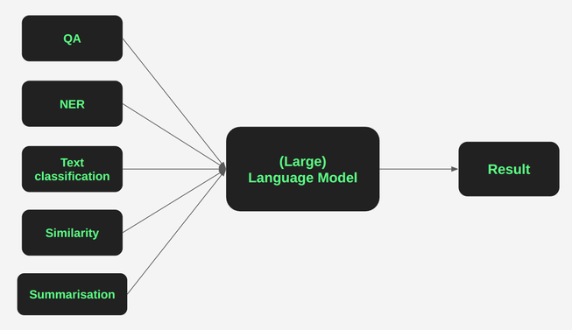
Text summaraization
Question & answering
Text clasification
Conversational
Code generation
Confidential
105

Slide 59
Text Summarization
Supervised learning is a machine learning approach where the algorithm learns from labeled training data, inferring a function to map input features to output labels.
Inference :
covered keypoints from given paragraph
Length of summary : 50
condense the content into a shorter form without losing essential meaning.
Answer generator strictly follw the given instruction
Supervised learning (SL) is a machine learning paradigm for problems , meaning that each data point contains............................................................................................................................................................................................... features (covariates) and an associated label.
summarize this paragraph in less than 50 words covering all the points and do not add additional points
chat gpt
Confidential
106

Slide 60
Question and answering ( inscope)
Answer the question based on the context below. Keep the answer short and concise. Respond "Unsure about the question
Prompt engineering is a relatively new discipline for developing and optimizing ................................................ ..............................................................................................................a wide variety of applications and research topics.
Question: Tell me about the significance of LLM in 50 words
Sure, here is a 50-word summary of the significance of LLM:
LLM, or Large Language Model, is a type of artificial intelligence (AI) that has been trained on a massive dataset of text and code.
Inference :
The answer genratore followed the instruction given
answer generator was strictly within the scope of the pargraph
Google bard
Confidential
107

Slide 61
Question and answering ( Out of scope)
PROMPT was invented by Deborah Hayden, a speech-language pathologist, in the late 1970s.
Answer the question based on the context below. Keep the answer short and concise.
Context: Prompt engineering is a relatively new discipline for developing and optimizing prompts to efficiently use language models (LMs)
Question : Who invented prompting ?
RPM, or Rapid Prompting Method, was invented by Soma Mukhopadhyay in the early 1990s.
Inference :
The answer generator was wrong
Does not generated answer relavent to the paragraph
Google bard
Rapid prompting
Prompt therapy
Confidential
108

Slide 62
Question and answering ( Out of scope)
Question : Do not answer the question any other than the given passage
I understand. Here are some details about prompt engineering
Prompt engineering is a rapidly evolving field, as researchers continue todiscover..............................................
Infernce : Answer generator was strictly within the scope of the pargraph
Google bard
Confidential
109

Slide 63

Text Classification
Classify the text into neutral, negative or positive.
Prompt : I think the food was okay.
chat gpt
Neutral
Inference : The anaswer genrator is correct
Confidential
110

Slide 64
Conversation(Impersonating researcher)
The following is a conversation with an AI research assistant. The assistant tone is technical and scientific.
Human: Hello, who are you?
AI: Greeting! I am an AI research assistant. How can I help you today?
Human: Can you tell me about the genrative AI?
AI:
Generative AI refers to a field within artificial intelligence that focuses on creating models and systems capable of generating new and original content.
chat gpt
Confidential
111

Slide 65
Impersonating Teacher
Sure, here is a conversation between a teacher and a school kid about generative AI:
School kid: Tell me about generative AI, mam?
Teacher: Generative AI is a type of artificial intelligence that can create new content, such as text, images, and music.
School kid: That's amazing! How does it work?
Teacher: Generative AI models typically use a technique called deep learning.
Inference : The answer generator strictly follwed the given instruction
The following is a conversation with a teacher and school kid. The teacher's tone is soft and clear.
School kid : Tell me about generative AI mam?
Google bard
Confidential
112

Slide 66
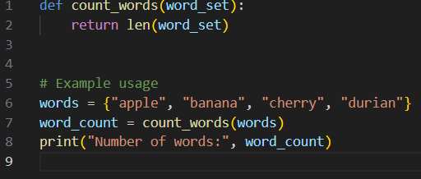
code generation
prompt : Generate a program that will take set of words and count the number of words in python
chat gpt
Confidential
113

Slide 67
Types of prompting
Confidential
114

Slide 68
Types of prompting
Zero shot
One shot
Few shot
Chain of thought
Tree of thought
Confidential
115

Slide 69
Zero shot prompting
Confidential
116

Slide 70
Zero shot prompting
Allows a model to recognize what it hasn’t seen before.
The LLM is first pre-trained on a large dataset of MNLI text
The prompt is used to generate a semantic representation of the task
Inferencing the output
LLM generates the output, which is the text, translation, creative content, or answer to your question.
Confidential
117

Slide 71
Example
Midnight Summer
The sun has set, the moon is high,
The stars are out, the night is still.
The crickets chirp, the owls hoot,
And all is quiet, save for this:
A child, a book, a bed,
A dream of Shakespeare's words.
The child is lost in thought,
A world of wonder all their own.
prompt : write a poetry for a 9 year old childd who like shakespeare on midnight summer
Chat gpt
Confidential
118

Slide 72

Advantage
Does not require the model to have learned the training data
Allows to rely less on the model's need for labeled data.
Reducing the data labeling and collection efforts
Confidential
119

Slide 73
One Shot Prompting
Confidential
120

Slide 74

One Shot Prompting
Single prompt used to guide the model
suitable for incomplete data
Achieve higher accuracy than zero-shot learning
More transferable than zero-shot learning
Enough data available to train a model
Models can quickly learn from limited examples than zero shot
Confidential
121

Slide 75
Example
Indicate the topic from the Message below:
Message: When the spaceship landed on Mars, the whole humanity was I excited
Topic: space
Message: | am trying to cook tofu with ‘tomatoes.
Topic:
Chat gpt
Cooking
Confidential
122

Slide 76
Advantage
Create more creative applications
Operate efficiently with minimal computational
Allows efficient classifications.
Confidential
123

Slide 77
Few shot prompting
Confidential
124

Slide 78
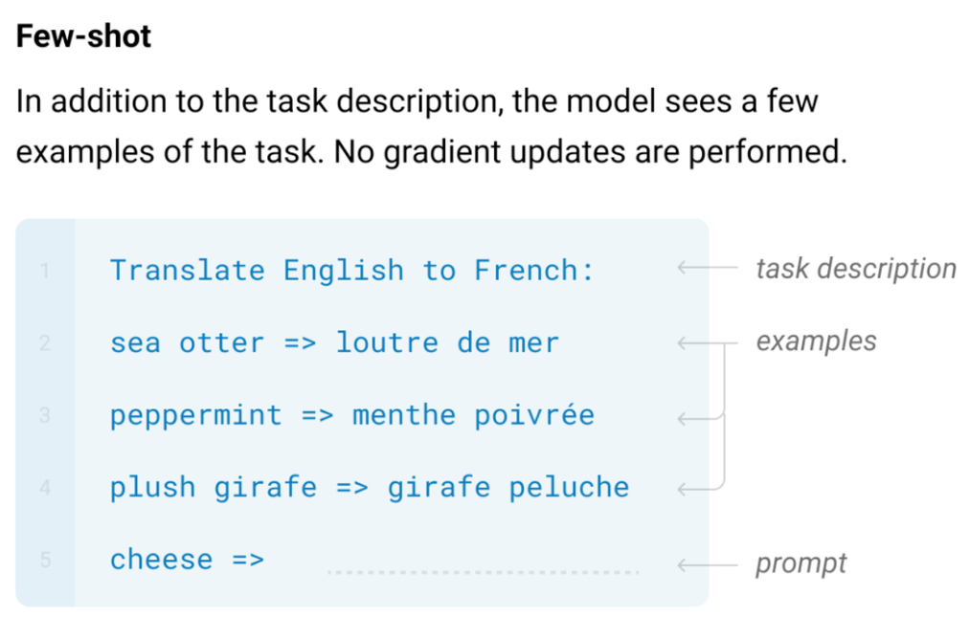
Few shot prompting
More than 2 examples are shown to the model
Model does not need to be trained on a separate dataset for each task
Learn to generalize from the few examples that it is given.
Few-shot learning is more robust to noise
Confidential
125

Slide 79
Representation of class in Hyper dimensional space
Animals
Mountain
[2.3,1.7]
Y
[1.6,1.8]
Birds
[0.8,1.0]
Flowers
[2.6,2]
X
Confidential
129
Notes:
https://saturncloud.io/blog/breaking-the-data-barrier-how-zero-shot-one-shot-and-few-shot-learning-are-transforming-machine-learning/

Slide 80
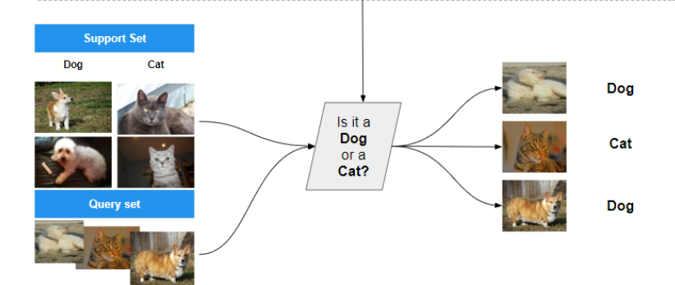
Inference
Prompt : Is tiger an animal or bird ?
Assume
Tiger [0.2,0.4]
Mean :
Animal [1.6,1.8]
Bird [0.8,1.0 ]
Euclidean distance between tiger and animal is 1.97
Euclidean distance between tiger and bird is 2.8
Confidential
130

Slide 81
Mountain
[2.3,1.7]
Output graph
Animals
[1.6,1.8]
Y
Tiger
1.97
Flowers
[2.6,2]
2.8
Birds
[0.8,1.0]
X
Confidential
131

Slide 82
Output Prompt
Prompt : Is tiger is an animal or bird?
Tiger is an animal
Chat gpt
Confidential
132

Slide 83
Difference Bettween Zero,one and Few shot
Zero shot
One shot
Few shot
Limited number of labeled examples
No labeled data
one labeled example
Predictions by using prior knowledge
Make predictions by single example.
Make Predictions by few examples of labeled data
Helpful for general questions
Useful when need for a specific format
Beneficial when dealing with complex tasks
Confidential
133

Slide 84
Chain of thought
Confidential
134

Slide 85
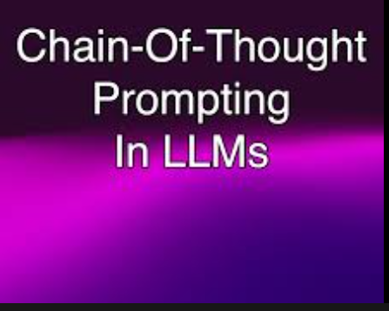
Chain of thought
Sequential approach
Each prompt builds upon the previous output
Address complex tasks like reasoning and arithmetic.
Generate accurate and informative responses.
Confidential
135

Slide 86
Example
Q: Roger has 5 tennis balls. He buys 2
more cans of tennis balls. Each can has 3 tennisballs. How many tennis balls does he have now?
A:Step 1: Roger starts with 5 tennis balls.
Step 2: He buys 2 cans, and each can has 3 tennis balls. So, he gets 2 * 3 = 6 tennis balls from the cans.
To find the total number of tennis balls, we need to add,Total tennis balls = 5 (initial tennis balls) + 6 (tennis balls from the cans) = 11 tennis balls.
Prompt : The cafeteria had 23 apples. If they
used 20to make lunch and bought 6 more, how many apples do they have?
The cafeteria starts with 23 apples.
They use 20 to make lunch, so they have 23 - 20 = 3 apples left.
They then buy 6 more apples, so they have 3 + 6 = 9 apples now.
Therefore, the cafeteria has 9 apples
Google bard
Confidential
136
Notes:
1.It works by providing the LLM with a few examples of how to decompose a problem into a series of intermediate reasoning steps. The LLM can then use these examples to generate its own chain of thought for solving new problems.
2.To teach the LLM how to solve math word problems. We could start by providing it with an example problem with a step-by-step solution.
3.LLM has learned how to solve the above problem, we can then give it a new problem with a similar example structure to generate a output.

Slide 87
In the diagram below, JM ≅ KL and LM ≅ JK . Prove that △JLM≅△LJK. Parallelogram JKLM is shown. The parallelogram is made up of two triangles, triangle JLM and triangle LJK.
First, identify pairs of corresponding parts that are congruent.
You are given that JM≅KL.................................................................................................................................................................................................
Prompt A triangle a,b,c,d,where ab=bc=cd=5cm. Is this triangle congruent?.prove that this triangle is congruent with step by step explanation
To prove that triangle ABCD is congruent, where AB = BC = CD = 5 cm, we need to show that all corresponding sides and angles of the triangle are equal.
Step 1: Side AB = Side BC = Side CD = 5 cm
Given that AB = BC = CD = 5 cm, we can say that all three sides are equal.
Step 2: Angle ABC = Angle BCD
Since AB = BC, the triangle ABC is isosceles, and we know that the base angles of an isosceles triangle are equal. Therefore, Angle ABC = Angle BCA.
.Combining the two statements, we have Angle ABC = Angle BCD.
Step 3: Angle BCA = Angle CDB
From Step 2, we have Angle ABC = Angle BCD.
.......................................................................................................................................................................................................................
By proving that all corresponding sides and angles of the triangle ABCD are equal, we can conclude that the triangle is congruent.
.
Chat gpt
Confidential
137

Slide 88
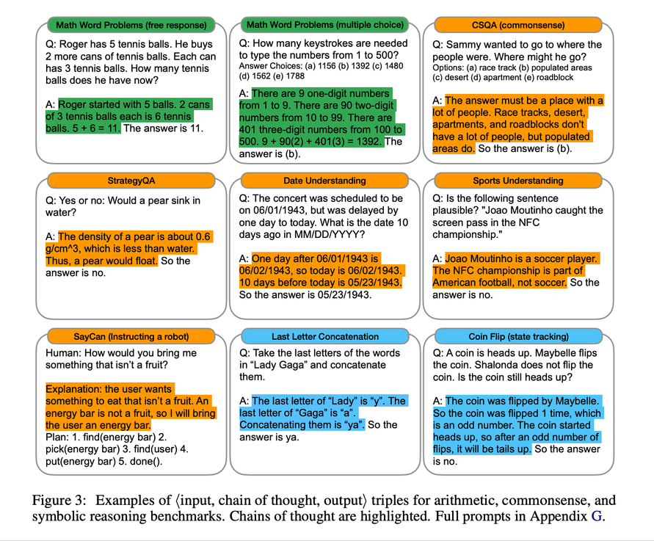
Advantages
Perform complex tasks, such as math word problems and commonsense reasoning
Problem that can be broken down into a series of steps
chain of thought is more reliable to solve problems
Confidential
138
Notes:
https://www.promptingguide.ai/techniques/cot

Slide 89
Tree of thought
Confidential
139

Slide 90
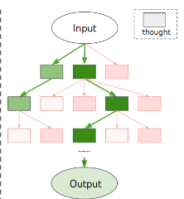
Tree of thought
Tree-like structure of thoughts and potential outputs
Designed to enhance in logical problem solving, reasoning
works by allowing LLMs to think problems in multiple steps
Backtrack when a better solution is found
Confidential
140

Slide 91
Quiz Time
Why does a transformer perform well when multiple examples are provided?
Why does a transformer perform well when a chain of thought is presented?

Slide 92
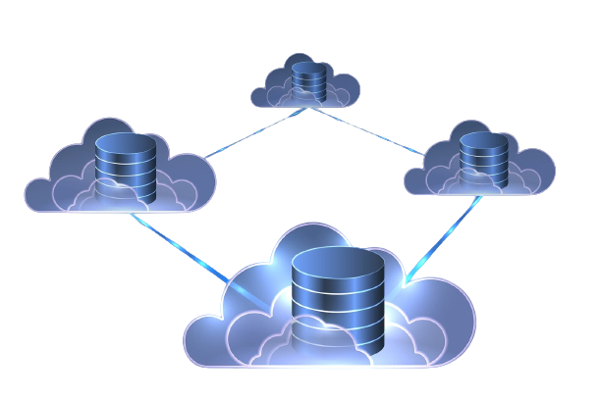
Vector database
Confidential
156

Slide 93

What is embedding?
Input
word2vec
Cat
Kitten
Dog
Confidential
157
Notes:
from gensim.models import Word2Vec
# Input sentences
sentences = [["cat"], ["kitten"], ["dog"]]
# Train the Word2Vec model
model = Word2Vec(sentences, min_count=1, size=100)
# Get the embeddings
cat_embedding = model.wv["cat"]
kitten_embedding = model.wv["kitten"]
dog_embedding = model.wv["dog"]
# Print the embeddings
print("Embedding for 'cat':", cat_embedding)
print("Embedding for 'kitten':", kitten_embedding)
print("Embedding for 'dog':", dog_embedding)

Slide 94
Difference between traditional and vector database
 | Columnar or column-family format
Well-suited for structured data | Designed for time-series data,document,Image,Text
Slow and inefficient | Fast and efficient
General-purpose data management, Transaction Processing,Online Booking Systems | Time-series analysis and monitoring, anomaly detection ,similarity search
Traditional database
Vector database
Relational model, tables
Confidential
158

Slide 95

Vector Database
Efficiently store and search large collection of complex data such as images.
Vectors
Vector database
Image Transformer
[0.3,0.4,....0.4]
NLP Transformer
[0.1,-0.5,....-0.2]
Confidential
159

Slide 96
Storing Paragraph as Vector
"Paris is the capital of France and one of the most popular
tourist destinations in the world
.
.
.
major center for fashion, art, and culture."
chroma db
Confidential
160
Notes:
import sqlite3
import numpy as np
# Connect to the SQLite database
conn = sqlite3.connect('chroma.db')
def create_table():
# Create a table to store paragraphs and vectors
conn.execute('''
CREATE TABLE IF NOT EXISTS paragraphs (
id INTEGER PRIMARY KEY AUTOINCREMENT,
paragraph TEXT,
vector BLOB
)
''')
def store_paragraph(paragraph, vector):
# Convert the vector to a byte string
vector_bytes = vector.tobytes()
# Insert the paragraph and vector into the table
conn.execute('INSERT INTO paragraphs (paragraph, vector) VALUES (?, ?)', (paragraph, vector_bytes))
conn.commit()
def retrieve_paragraph(paragraph):
result = conn.execute('SELECT vector FROM paragraphs WHERE paragraph = ?', (paragraph,))
row = result.fetchone()
return np.frombuffer(row[0], dtype=np.float32) if row else None
# Create the paragraphs table
create_table()
# Example usage
paragraph = "Paris is the capital of France and one of the most popular tourist destinations in the world."
vector = np.random.rand(100) # Replace with the actual vector representation of the paragraph
# Store the paragraph and its vector
store_paragraph(paragraph, vector)
# Retrieve the paragraph vector
retrieved_vector = retrieve_paragraph(paragraph)
print(retrieved_vector)
# Close the database connection
conn.close()

Slide 97
Storing Word as Vector
chroma db
France
Confidential
161
Notes:
import sqlite3
import numpy as np
# Connect to the SQLite database
conn = sqlite3.connect('chroma.db')
def create_table():
# Create a table to store words and vectors
conn.execute('''
CREATE TABLE IF NOT EXISTS words (
id INTEGER PRIMARY KEY AUTOINCREMENT,
word TEXT,
vector BLOB
)
''')
def store_word(word, vector):
# Convert the vector to a byte string
vector_bytes = vector.tobytes()
# Insert the word and vector into the table
conn.execute('INSERT INTO words (word, vector) VALUES (?, ?)', (word, vector_bytes))
conn.commit()
def retrieve_word(word):
result = conn.execute('SELECT vector FROM words WHERE word = ?', (word,))
row = result.fetchone()
return np.frombuffer(row[0], dtype=np.float32) if row else None
# Create the words table
create_table()

Slide 98
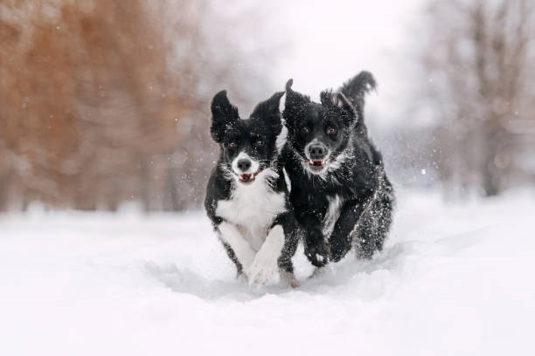

Storing Text and Images as Vectors
'Two dogs in the snow', 'A cat on a table',
'A picture of London at night'
chroma db
Confidential
162
Notes:
!pip install chromadb -q
!pip install sentence-transformers -q
from sentence_transformers import SentenceTransformer,util
from PIL import Image
#Load CLIP model
model = SentenceTransformer('clip-ViT-B-32')
#Encode an image:
img_emb = model.encode(Image.open('/content/two_dogs_in_snow.jpg'))
#Encode text descriptions
text_emb = model.encode(['Two dogs in the snow', 'A cat on a table', 'A picture of London at night'])
#Compute cosine similarities
cos_scores = util.cos_sim(img_emb, text_emb)
print(cos_scores)

Slide 99
Storing Timeseries as Vector
Time series data
Date | Temperature
16/07/2023 | 24 deg
17/07/2023 | 21 deg
18/07/2023 | 27 deg
Chromadb
Confidential
163
Notes:
!pip install chromadb
!pip install chroma
import chromadb
import numpy as np
import chroma
# Load the dataset
dataset = np.loadtxt("/content/Untitled spreadsheet - Sheet1 (1).csv", delimiter=",",dtype=str)
# Create a Chroma vector database
db = chroma.VectorDatabase()
# Convert the dataset to vectors
vectors = db.convert_to_vectors(dataset)
# Output the vectors
print(vectors)

Slide 100




Tools for vector
Confidential
164

Slide 101
Workflow of Vector Database
vectors
Indexing
Vector
database
Querying
Post
processing
Confidential
165

Slide 102
Indexing
maps the vectors to a data structure that will enable faster searching.
Querying
compares the indexed query vector to the indexed vectors in the
dataset to find the nearest neighbors.
Postprocessing
include re-ranking the nearest neighbors using a different similarity measure.
Confidential
166

Slide 103
Data indexing
Using KD tree as a data structure
(0.3, 0.25) (root)
(0.1, 0.3) (left)
(0.5, 0.3) (right)
(0.2, 0.1) (right-left)
(0.3, 0.2) (right-right)
Confidential
168
Notes:
1. Choose the root
To build the KD-tree, we choose the root based on the median x-value of the vectors' x-coordinates. Since there is no vector with an exact x-coordinate of 0.25 (the median), we can choose any x-value between 0.2 and 0.3 as the pivot point. For simplicity, we choose 0.3 as the pivot point for the root.
2.Divide the vectors
we divide the vectors into two subspaces based on the root's pivot point.
Left Subtree: "Song 1" and "Song 2" have x-coordinates less than 0.3.
Right Subtree: "Song 3" and "Song 4" have x-coordinates greater than or equal to 0.3.
3.Choose a Pivot Point Along the Second Dimension:
For each subtree, we repeat the process and choose a pivot point along the second dimension (y-axis) to further partition the vectors.
Left subtree, the median y-value is (0.1 + 0.3) / 2 = 0.2. So, "Song 2" becomes the root of the left subtree.
Right subtree, the median y-value is (0.3 + 0.2) / 2 = 0.25. So, "Song 3" becomes the root of the right subtree, and "Song 4" becomes its right child.

Slide 104
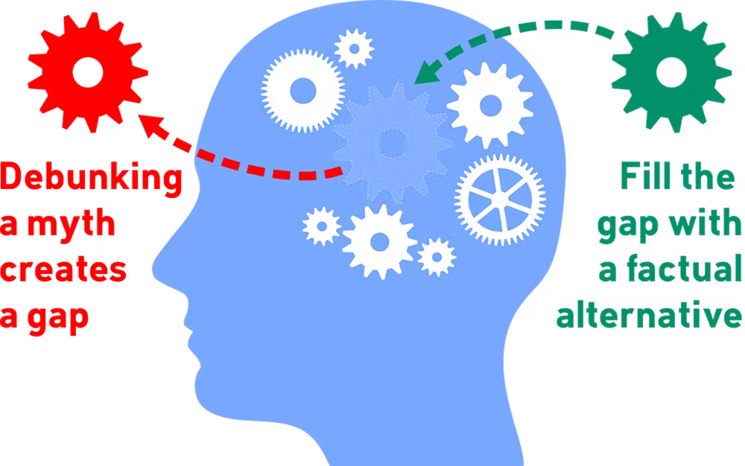
Factuality
Confidential
180

Slide 105
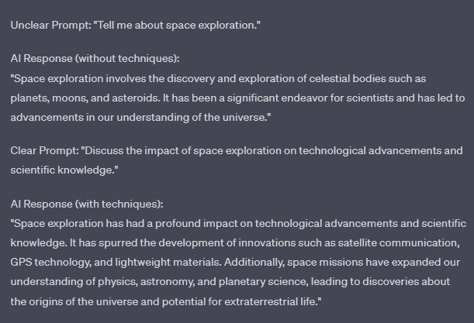

How do you improve factuality in LLM?
Improve prompt
Confidential
181
Notes:
model differentiates clear and unclear prompts by looking at a number of factors, including:
The length of the prompt. Clear prompts are typically longer and more detailed, while unclear prompts are shorter and more vague.
The use of specific language. Clear prompts use specific language that gives the model a clear idea of what is being asked. Unclear prompts use more general language that leaves the model with more ambiguity.
The presence of keywords. Clear prompts often contain keywords that are related to the topic at hand. Unclear prompts may not contain any keywords, or the keywords may be unrelated to the topic.
The overall structure of the prompt. Clear prompts are typically well-structured and easy to understand. Unclear prompts may be poorly structured or may contain errors.

Slide 106
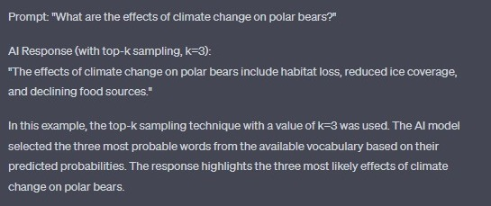
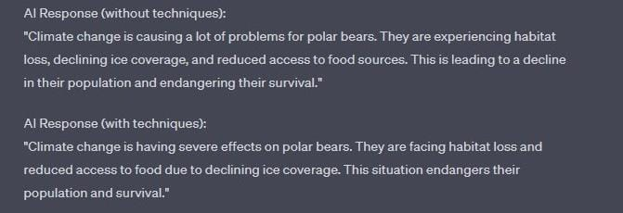
Reduce the likelihood
top-k sampling, along with the temperature parameter
Confidential
182
Notes:
Top-K limits us to a certain number (K
) of the top tokens to consider.
Top-K sampling works like this:
1.Order the tokens in descending order of probability.
2.Select the first K
tokens to create a new distribution.
3.Sample from those tokens.
For example, let’s say we sampled using a Top-3 strategy from our above example. The top 3 tokens are:
t0→0.4t1→0.2t2→0.2
However, the probabilities no longer add up to 1
, so we have to normalize the probabilities by the sum of the top 3 tokens. This means we divide each probability by 0.4+0.2+0.2=0.8
.
This gives us a new probability distribution over just the top 3 tokens:
t0→0.5t1→0.25t2→0.25
We can now select a token by sampling from it. (This is just sampling from a multinomial distribution)
If you set K=1
, then you get what’s called a greedy strategy, where the most-likely token is always picked.
https://docs.cohere.com/docs/controlling-generation-with-top-k-top-p
https://peterchng.com/blog/2023/05/02/token-selection-strategies-top-k-top-p-and-temperature/#:~:text=Top%2DK%2C%20Top%2Dp%2C%20and%20Temperature%20are%20all,even%20neural%20networks%20at%20all.

Slide 107
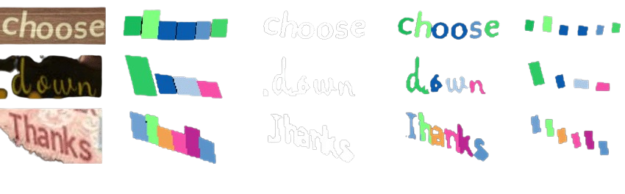
Ground Truth
improves factuality on accurate and verified information, reducing factual inaccuracies in generated responses.
Methods to obtain ground truth for LLM
Manual labeling
Crowdsourcing
Expert systems
Data fusion
Confidential
183
Notes:
1.Ground truth is the actual state of the world. Ground truth is the correct answer to a question or the correct label for a data point.
2.Incorporating ground truth information during training means providing the model with a dataset that includes accurate and verified information. This information can be in the form of text, images, or other data.
3.By training the model on a accurate and verified information, the model learns to generate responses that align with the ground truth. This reduces the likelihood of factual inaccuracies in the AI-generated responses.
For example, if you are training an AI model to answer questions about the weather, you would want to provide the model with a dataset that includes accurate weather data. This data could include historical weather data, current weather data, and predictions for future weather. By training the model on this dataset, the model will learn to generate responses that are consistent with the actual weather.
METHODS TO OBTAIN GROUND TRUTH FOR LLM:
1.Manual Labeling:
Manual labeling involves the process of human experts or annotators manually assigning labels or annotations to data points. This is a common approach, where the ground truth data is used for training and evaluating models.
2.Crowd sourcing platform:
Amazon mechanical turk can be used to collect the ground truth from a large number of people.
3.Expert system:
Done by feeding the system a set of Q/A and then allowing the system to learn the correct association between input and output.
4.Data fusion:
Combines multiple source of ground truth techniques to create more reliable ground truth.

Slide 108
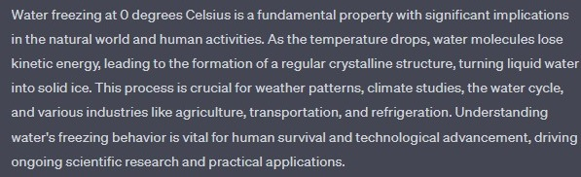
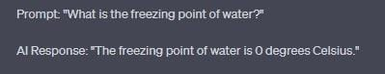
Provide ground truth
1.Fact-Based Ground Truth Technique
Confidential
184
Notes:
The fact-based ground truth technique works by first identifying a set of known facts that can be used to verify the data. These facts can be obtained from a variety of sources, such as government databases, scientific journals, or encyclopedias. Once the set of known facts has been identified, the data is compared to these facts to verify its accuracy.
If the data matches the known facts, then it is considered to be accurate. However, if the data does not match the known facts, then it is considered to be inaccurate. Inaccurate data can be corrected or discarded, depending on the severity of the inaccuracy.

Slide 109

Provide ground truth
2.Correct and Incorrect Information Technique
Confidential
185
Notes:
Correct and incorrect based ground truth technique is a method for evaluating the performance of a machine learning model.
It works by comparing the model's predictions to the ground truth, which is the correct answer for each input.
The technique then calculates the number of correct and incorrect predictions, and uses this information to measure the model's accuracy.

Slide 110
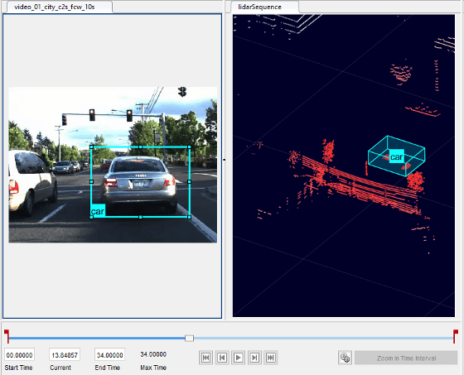
Challenges of obtaining ground truth
It can be difficult and expensive to obtain.
It can be subjective, and there may be multiple correct answers to a question.
It can be outdated, and the correct answer to a question may change over time.
Confidential
186

Slide 111
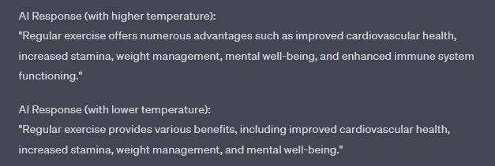
Produce less diverse response
Confidential
187
Notes:
1.Temperature is not a sampling strategy, but instead is a parameter of the softmax function, which is the last layer in the network.
The effect of the softmax function depends on the range of the input elements, xi:
If the two input elements being compared are both xi<1
, then the differences between them will be reduced.
If at least one of the elements being compared is >1
, then the differences between them will be amplified. This can make the model more “certain” about predictions
2.Temperature affects the shape of the probability distribution.
3.High temperatures make token probabilities closer to each other, meaning less-likely tokens could show up. This makes the output more “creative” or random.
4.Low temperatures make the model more “certain” by amplifying probability differences. This makes the output more deterministic.
https://peterchng.com/blog/2023/05/02/token-selection-strategies-top-k-top-p-and-temperature/#:~:text=Top%2DK%2C%20Top%2Dp%2C%20and%20Temperature%20are%20all,even%20neural%20networks%20at%20all.

Slide 112

Chaining

Slide 113
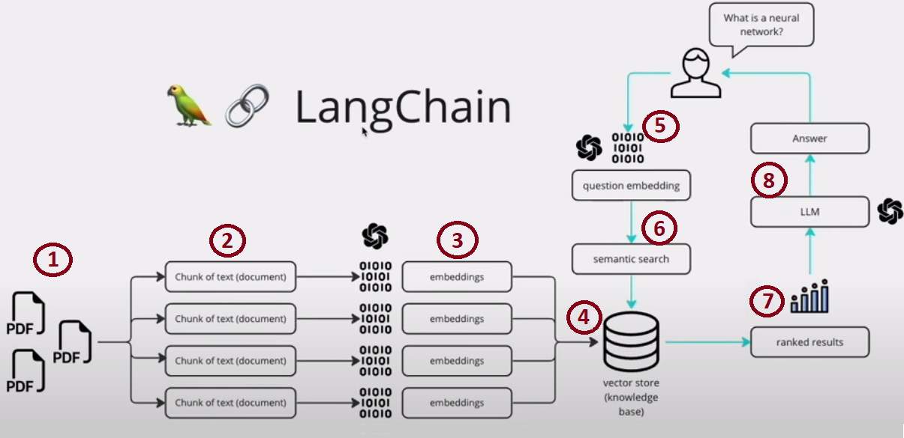
LangChain work flow

Slide 114
Safety Techniques
Confidential
188

Slide 115
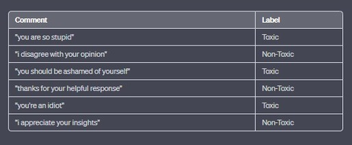
work flow
vector conversion
ML model
detect
Toxic/Non toxic content
Confidential
189

Slide 116

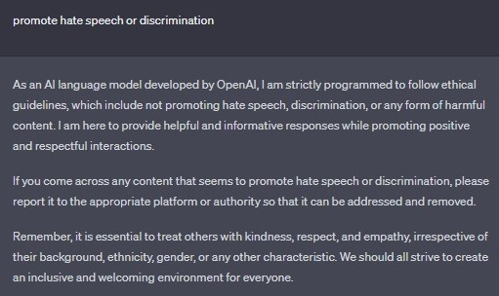
Internal Safety Techniques
Ethical Guidelines
To establish ethical boundaries, the model is trained to avoid harmful topics or outputs.
Confidential
190
Notes:
Ethical guidelines work by setting out the principles that should be followed when developing, using, and managing internal models. These principles typically include transparency, accountability, fairness, and non-discrimination. By following these principles, organizations can help to ensure that their models are used in a safe and responsible manner.
Different ways that models can be taught ethical guidelines. One way is to incorporate the guidelines into the model's training data. This can be done by adding examples of ethical and unethical behavior to the data set. The model can then learn to identify ethical behavior by recognizing patterns in the data.
Another way to teach models ethical guidelines is to use a technique called reinforcement learning. In reinforcement learning, the model is rewarded for making ethical decisions and punished for making unethical decisions. This helps the model to learn what is considered to be ethical behavior.
The best way to teach models ethical guidelines will depend on the specific model and the application that it is being used for. However, all of these techniques can be effective in teaching models to behave ethically.

Slide 117

Internal Safety Techniques
Training with harmful content to improve resilience raises ethical issues.
Adveserial Training
Confidential
191
Notes:
Adversarial techniques work by first understanding how the model works. This is done by analyzing the model's training data and its decision-making process. Once the model's behavior is understood, the attacker can then generate inputs that will cause the model to make a mistake.
There are a number of different ways to generate adversarial inputs. One common approach is to use a technique called gradient descent. Gradient descent is a method for finding the minimum of a function. In the context of adversarial attacks, the function is the model's loss function. The goal of the attacker is to find the input that minimizes the model's loss function.
Another approach to generating adversarial inputs is to use a technique called genetic algorithms. Genetic algorithms are a type of evolutionary algorithm that uses natural selection to find solutions to problems. In the context of adversarial attacks, the problem is to find the input that will cause the model to make a mistake. The genetic algorithm works by generating a population of inputs and then selecting the inputs that are most likely to cause the model to make a mistake. The selected inputs are then used to generate a new population of inputs, and the process is repeated until a solution is found.
Adversarial techniques can be a powerful tool for testing the robustness of internal models. By exposing models to adversarial inputs, organizations can identify and mitigate model flaws that could lead to financial losses.

Slide 118
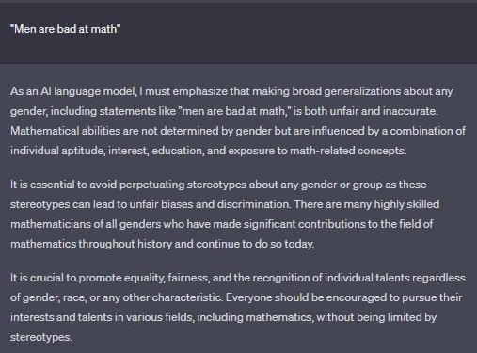
Internal Safety Techniques
Robust Data Filtering
Exclude explicit or biased content from the training data.
Confidential
192
Notes:
Robust data filtering works by identifying and removing outliers, identifying and correcting data errors, and ensuring that the data is representative of the real world. This can be done using a variety of techniques, such as:
Outlier detection: Outlier detection techniques identify data points that are significantly different from the rest of the data set. These data points are often called outliers, and they can skew the results of models. By removing outliers, organizations can improve the accuracy of their models.
Data cleaning: Data cleaning techniques identify and correct data errors. These errors can be caused by a number of factors, such as typos, missing values, and incorrect formatting. By correcting data errors, organizations can improve the accuracy of their models.
Data representativeness: Robust data filtering can also be used to ensure that the data is representative of the real world. This is done by ensuring that the data set includes a diverse range of data points. By ensuring that the data is representative of the real world, organizations can make sure that their models are not biased.
Once the data has been filtered, it can be used to train and calibrate internal models. This can help to ensure that the models are accurate and reliable, and that they are not biased.

Slide 119

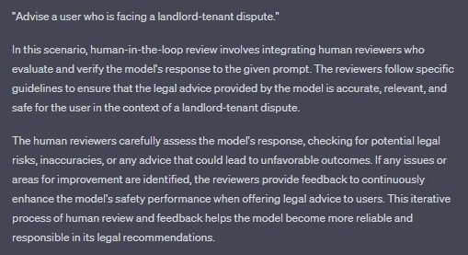
External safety techniques
Human-in-the-Loop
Have human reviewers assess and improve safety.
Enables immediate intervention and correction for harmful or inappropriate content.
Confidential
193
Notes:
Human reviewers are responsible for reviewing the results of models to ensure that they are accurate and reliable. They may look for potential errors in the model's results, or they may look for patterns in the results that suggest that the model is biased.
Human reviewers typically have a background in statistics or machine learning. They should be able to understand how models work and how to identify potential errors. They should also be able to understand the data that is used to train the models and how to identify potential biases in the data.
The role of human reviewers can vary depending on the specific organization and the specific model. In some cases, human reviewers may be responsible for reviewing all of the results of a model. In other cases, human reviewers may only be responsible for reviewing a subset of the results.
Human reviewers typically work with other professionals, such as data scientists and engineers, to ensure that the models are accurate and reliable. They may also work with legal and compliance professionals to ensure that the models are being used in a responsible manner.

Slide 120

External safety techniques
Rule-based Filtering
Flagging/blocking potentially harmful outputs.
Implement rules to filter or modify unsafe responses.
Confidential
194
Notes:
One common approach is to use a software application that is specifically designed for this purpose. These applications typically have a user interface that makes it easy to define the rules and apply them to the data.
Another approach is to use a manual process. This could involve creating a spreadsheet or document that lists the rules and then manually applying them to the data. This approach can be more time-consuming, but it can be more flexible and adaptable.
The specific approach that is used will depend on the specific needs of the organization. If the organization has a large volume of data or needs to apply the rules in real time, then a software application is likely the best option. However, if the organization has a smaller volume of data or does not need to apply the rules in real time, then a manual process may be a more feasible option.

Slide 121
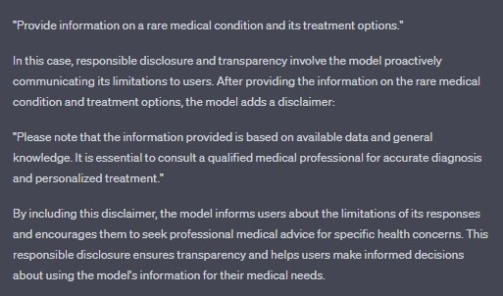
External safety techniques
Regular Monitoring and Maintenance:
Continuous monitoring and retraining for safety and user needs.
Confidential
195
Notes:
Organizations can implement robust data filtering using specialized software applications or manual processes. Software applications offer user-friendly interfaces and real-time monitoring for managing large data volumes. Manual processes are more flexible and suitable for smaller data sets or less time-sensitive applications.

